Slide 1
E-SAFETY
ADVICE AND GUIDANCE FOR PARENTS

Slide 2
How are your children using the internet?
Social networking
Facebook/ Youtube / Twitter /Instagram
Instant messaging
Facetime/Skype/ Whatsapp/Snapchat
Blogs and chat sites
Tumblr / Ask FM / Spillit
Gaming
Consoles / free and paid / Club Penguin / Minecraft
Mobile technology
Apps

Slide 3
What issues could be affecting your children?

Slide 4
Cyber Bullying
Cyberbullying is when someone bullies others using electronic means. The behaviour is usually repeated.
Like any form of bullying, cyberbullying can be horrible for the children involved and hard for them to talk about.
Cyberbullying can happen via text, email and on social networks and gaming platforms. It can consist of:
Threats and intimidation
Harassment and stalking
Defamation
Rejection and exclusion
Identify theft, hacking into social media accounts and impersonation
Publically posting or sending on personal information about another person
Manipulation

Slide 5
Cyber Bullying
It can reach a vast audience in a matter of seconds
It has the potential to draw in large numbers of people
It takes ‘repetition’ to a different level, with hurtful comments and images being shared multiple times
It has the potential to impact at any time of day or night
It can offer a degree of anonymity to the perpetrator
There are very few children that have not been impacted in some way, either as the perpetrator or the victim
It’s difficult to police and to punish
Why is cyberbullying different?
One of the biggest differences between cyberbullying and face-to-face bullying is that it can be hard to get away from. Young people could be bullied anywhere, anytime – even when they’re at home.

Slide 6
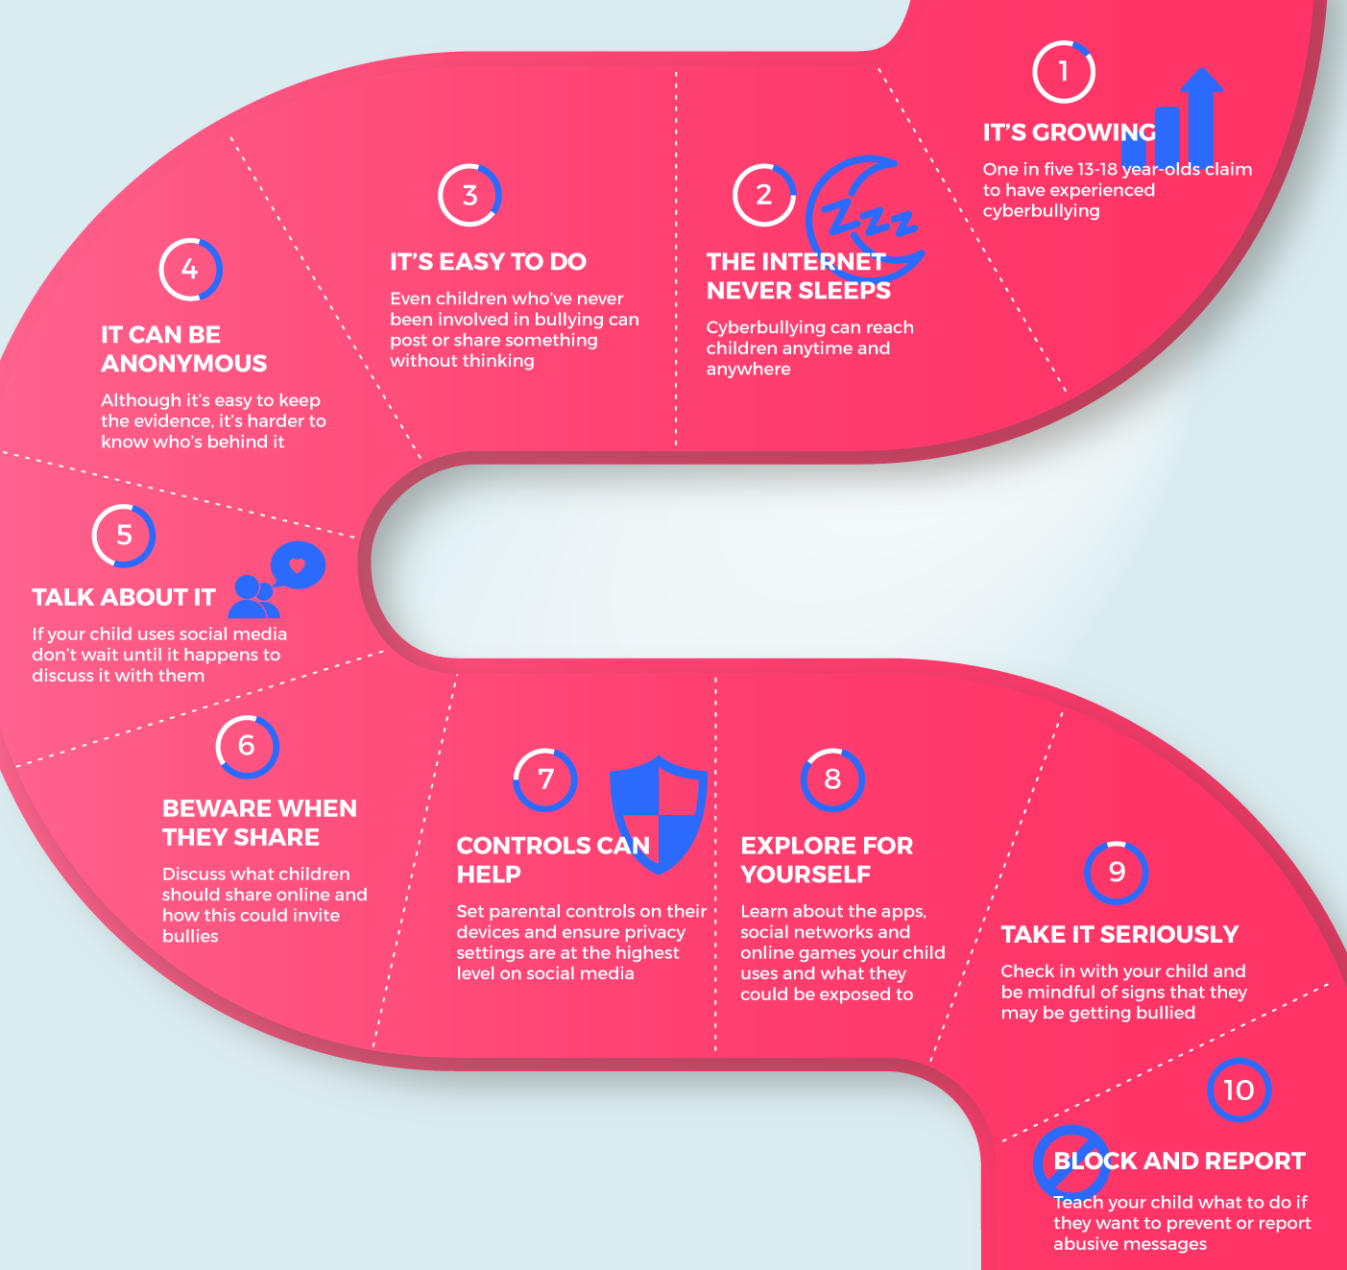
10 things you need to know about cyberbullying

Slide 7
Protect your child
Get Involved
The best way to keep your child safe online is to take an active interest right from the start. They need your love and protection online as much as they do in the real world. What your child is exposed to will depend on how they’re using the internet – social network users are more likely to experience cyberbullying, see sexual or violent images, or have contact with strangers.
Challenge your child and learn about e-safety together with our tablet app

Slide 8
Meaningful conversations
The earlier you can talk to your child about making positive choices online, the better. Here are some conversation starters:
What do they want to be online?
The choices we make online say something about who we. Talk to your child about how the things they do online paint a picture of themselves, so they shouldn’t post things without thinking about it.
How much should they share about themselves?
Talk to your child about the risks of sharing, identifying where they live or go to school, and what people online might do with that information. Talk about what the risks might be of sharing personal thoughts and feelings.
Read the NSPCC’s guide to making sure your child is ‘Share Aware’
How much time should they spend online?
Talk about the possible impact of spending too much time online and agree sensible ‘bed-times’ and breaks during the day. Create opportunities as a family to get ‘off-line’ and have fun together.

Slide 9
Set up safely
As a parent you have some decisions to make about how you want your child to engage online and on social media and what measures you want to put in place to help protect them:to co
Set up their device
Whatever device you choose, there are free controls you can use to stop your child from purchasing and using certain apps, seeing certain content, or limiting what they can share with others, like their location for example.
https://www.internetmatters.org/parental-controls/interactive-guide/

Slide 10
Set up safely
Getting the low down on sites, games and apps
You will probably use social networks yourself, but you might want to know about new ones that your child is using, or wants to use. Use them yourself and set up your own account so you can experience what your child might see. There are also a number of child-friendly social networks they could use while they get ready for the likes of Snapchat and Instagram.
Privacy settings
Spend time together looking at the privacy settings. It’s always best to assume that default settings are public and should be changed accordingly.
Advice on using privacy settings on the most popular social apps.
https://www.internetmatters.org/hub/guidance/social-networking-how-to-guides-for-parents/

Slide 11
Set up safely
Blocking software
There are a range of new apps and software that block, filter and monitor online behaviour. You’ll need to decide as a family whether this is the right approach for you, taking into consideration your child’s age and maturity, and their need for privacy.
Negotiating the gaming world
In some games like Minecraft people deliberately try to intimidate other players. In multi-player games where gamers talk to one another – you might find abusive language, harassment and there have been instances of grooming. It’s vital therefore that your child knows how to report abuse and talks to you if something is causing them concern.

Slide 12
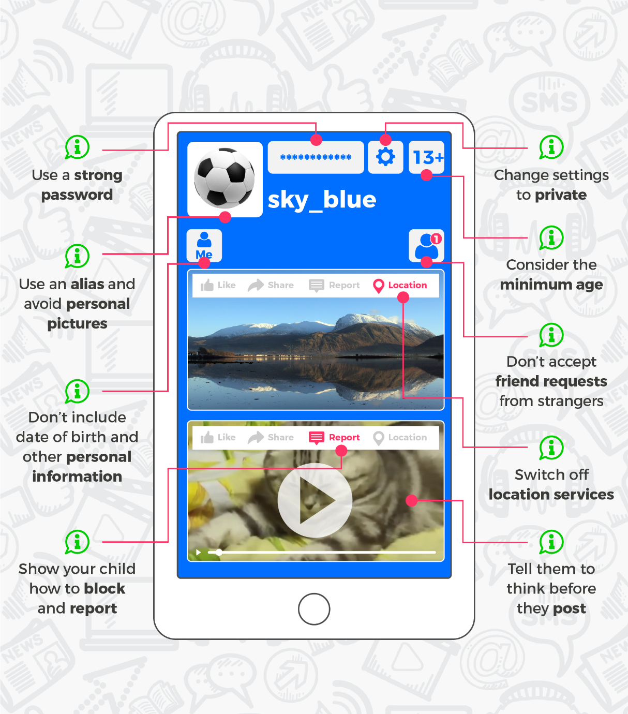
What does a good social media profile look like?
A good profile
Use their nickname and a profile picture of their pet or favourite band, rather than themselves, and encourage them to only be friends with people they know in real life. Avoid sharing personal information like school, age and place they live.

Slide 13
Inappropriate Content
What sort of inappropriate content might my child see?
Inappropriate content includes information or images that upset your child, material that’s directed at adults, inaccurate information or information that might lead or tempt your child into unlawful or dangerous behaviour. This could be:
pornographic material
content containing swearing
sites that encourage vandalism, crime, terrorism, racism, eating disorders, even suicide
pictures, videos or games which show images of violence or cruelty to other people or animals
gambling sites
unmoderated chatrooms – where there’s no one supervising the conversation and barring unsuitable comments.
It can be difficult to monitor what your child is viewing as they can access this material through any internet enabled device, including mobile ones such as a phone or tablet. Sometimes your child may stumble upon unsuitable sites by accident, through apps they’ve downloaded to their mobile device or through links they’ve been sent by friends, chatting to others online, or even through inter-device communication systems such as Bluetooth or Apple’s AirDrop.

Slide 14
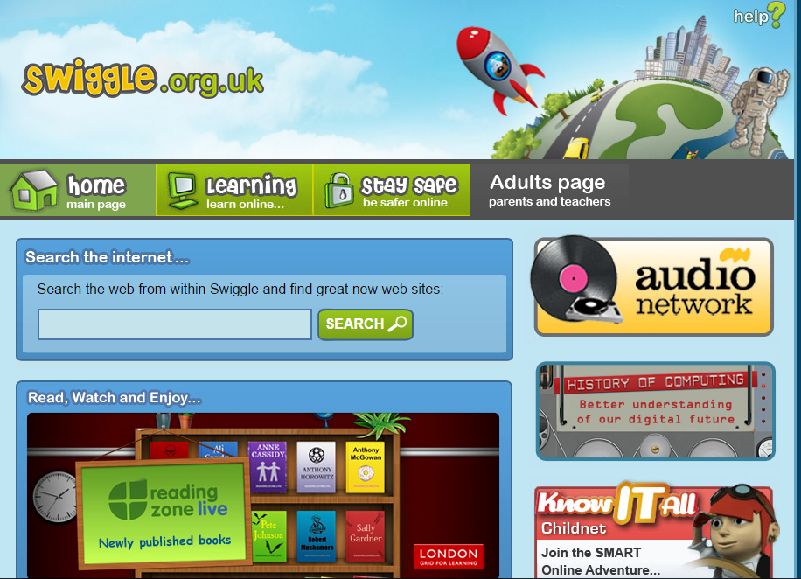
Talk to your child about avoiding inappropriate content
Start a conversation
As soon as your child starts to use the internet you should begin to talk about what they might find there. Help them understand that sometimes they may come across things that they’d prefer not to see, or that you would prefer they didn’t see. Try to have these conversations regularly.
Make sure they know about age limits
Many sites have a minimum age limit of 13 – this includes websites like YouTube and Facebook. Explain to your child that age limits are there to help protect them from unsuitable content.
Agree ground rules
Find out the kind of things your child likes to do online and agree which websites and apps are the best for them to use. These should include the search engines they use to find information.
Be calm and reassuring
Let your child know they can talk to you or a trusted adult if they come across anything that upsets them online.

Slide 15
Online Grooming
Groomers may go to a social network used by young people and pretend to be one of them. They might attempt to gain trust by using fake profile pictures, pretending to have similar interests, offering gifts and saying nice things to the child.
Once they have the child’s trust the groomer often steers the conversation towards their sexual experiences, even asking them to send sexual photographs or videos of themselves. Some may try to set up a meeting, or even blackmail children by threatening to share the pictures or videos with the child’s family and friends.
Online groomers are not always strangers. In many situations they may already have met them through their family or social activities, and use the internet to build rapport with them. Sometimes children don’t realise they’ve been groomed, and think that the person is their boyfriend or girlfriend.
https://youtu.be/Pt-9NI1qCKI
SWITCH OFF LOCATION SERVICES ON ALL DEVICES YOUR CHILD HAS ACCESS TO

Slide 16
Share aware
https://www.nspcc.org.uk/preventing-abuse/keeping-children-safe/share-aware/
https://www.nspcc.org.uk/preventing-abuse/keeping-children-safe/share-aware/
Sexting

Slide 17
Report and support
Report suspected online grooming – this could be a sexual chat, a child being asked to do something that makes them feel uncomfortable or someone insisting on meeting up
www.ceop.police.uk

