Slide 1
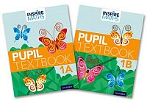
Inspire Maths Parents’ Information Evening 2017
The Singapore Approach

Slide 2
What is Inspire Maths?
Inspire Maths provides a highly scaffolded learning framework with problem solving at its heart. It is built on a focused, coherent and cumulative spiral curriculum that continuously builds and consolidates knowledge to reach deep understanding. The programme encourages extensive practice to develop fluency and mastery, so that every child-across all abilities – can succeed at mathematics.

Slide 3
What are the characteristics of a child who is good at maths?
INDEPENDENT LEARNER
PATTERN SPOTTER
RISK TAKER
GROWTH
MINDSET
(I can’t do it YET!!!!)
RESILIENT
SYSTEMATIC
PERSISTENT
EXPLORER

Slide 4
Textbooks….?
‘A coherent programme of high quality curriculum materials is used to support classroom teaching. Concrete and pictorial representations of mathematics are chosen carefully to help build procedural and conceptual knowledge together.
One medium for coherent curriculum materials is high quality textbooks. These have the additional advantage that pupils also use them to return to topics studied, for consolidation and revision.’
NCETM, Developing Mastery in Mathematics
Tim Oates: Why Textbooks Count
http://www.cambridgeassessment.org.uk/images/181744-why-textbooks-count-tim-oates.pdf

Slide 5
Bruner’s forms of representations
Students learn a new skill by using concrete materials, reinforcement is achieved by going back and forth between the representations.
Concrete Enactive – internalised action.
Pictorial Iconic – this can also be sensory imagery.
Abstract Symbolic – arbitrary symbols (words, numerals)

Slide 6
C-P-A
Children are expected to use and understand numbers, which are abstract concepts. Many children struggle with this and so their first experience of mathematics is confusing, leaving them with no solid foundation to build on for later learning. The CPA approach helps children achieve secure number sense – what numbers really represent and how to use them mathematically. This is done through a series of carefully structured representations – first using physical objects (concrete), then diagrams or pictures (pictorial), and ultimately using representations such as numerals (abstract).

Slide 7
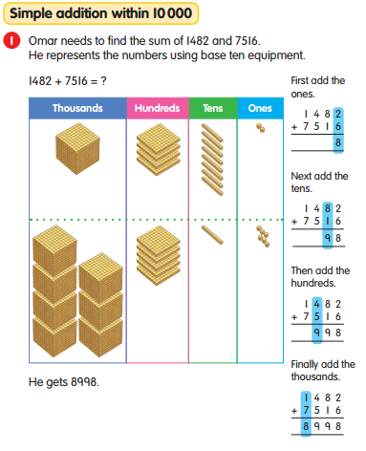

Slide 8
Spiral Approach
Jerome Bruner proposed a spiral curriculum.
Students first learn a concept or topic intuitively.
They then revisit the idea repeatedly, each time adding to what they have already mastered until full mastery.
Reinforcing and strengthening students’ understanding when a subject matter is revisited.
Initially it is enacted with concrete materials, later it is represented by models and then by abstract notation.

Slide 9
Bar Modelling
The bar model is a step-by-step method that helps children to understand and extract the information within a calculation or word problem.
By drawing a bar model, children translate a calculation or word problem into a picture. The approach helps children process information given in the problem, visualise the structure, make connections and solve the problem.

Slide 10
Why models?
To help pupils to process the information in the question. (Read)
Make sense of the question or problem. (Think and Plan)
Just one of the ways to comprehend the problem & from the models, pupils will be able to work out the solution.

Slide 11
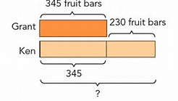
Bar Modelling
Different types of models
Discrete Model
Part-Whole Model
Comparison Model
Ratio Model
Change/Transforming Model or before and after model.

Slide 12
Discrete Model
Representations not pictures.
Each box represents 1 discrete item.
Theo has 4 cars and 3 lorries. How many toys has he got?
Theo has got _____ toys.
c c c c l l l

Slide 13
Part-Whole Model
Sofia has 107 sweets and Finley has 75 sweets.
How many sweets do they have altogether?
Represent this problem as a discrete model.
?
Always a question mark where the answer goes – this is what we are trying to find.
107
75

Slide 14
Part –whole model for addition and subtraction
The model represents a quantitative relationship among three variables: whole, part 1 and part 2. Given the values of any two variables, we can find the value of the third one by addition or subtraction.
Whole
Part 1
Part 2

Slide 15
Part-whole model - subtraction
Michelle baked 112 cakes.
She gave away 87 cakes.
How many cakes did she have left?
Michelle has _____ cakes left.
112
87
?

Slide 16
William has 135 stamps.
He has 60 less stamps than his brother.
How many stamps do William and his brother have altogether?
They have ____ stamps altogether.
135
+195
330
W
135
?
B
135
60

Slide 17
Comparison Model for addition and subtraction
The model represents a quantitative relationship among three variables: larger quantity, smaller quantity and difference. Given the values of any two variables, we can find the value of the third one by addition or subtraction.
Difference
Smaller quantity
Larger quantity

Slide 18
Comparison Models
Bryan has 166 marbles.
He has 40 more marbles than Christopher.
How many marbles does Christopher have?
Christopher has ____ marbles.
166
40
?

Slide 19
Part-whole model for multiplication and division
The following part-whole model represents a whole divided into 3 equal parts:
Whole
part
The model illustrates the concepts of multiplication as:
One part
x
Number of parts
=
Whole

Slide 20
Models for multiplication and division
Jerry has 60 marbles. Tom has 4 times as many marbles as Jerry. How many marbles do they have altogether?
Jerry and Tom have ____ marbles altogether.
60
Jerry
?
Tom

Slide 21
Multiplicative Comparison Models
One quantity is a multiple of the other, e.g.
Larger quantity
Smaller quantity
The larger quantity is 3 times as much as the smaller quantity, and the smaller quantity is equal to 1/3 of the larger quantity.

Slide 22
Ratio Model
The following part-whole model shows a whole divided into 3 parts A, B and C in the ratio 2:3:4.
Whole
Part A
Part B
Part C
The following comparison model shows three quantities A, B and C which are in ratio 2:3:4.
A
The ratio 2:3:4 means “2 units to 3 units to 4 units”
B
C

Slide 23
Model Drawing
Read the problem.
Rewrite the question in sentence form leaving a gap for the answer.
Think about what is being asked and which model supports the question.
Draw the bars.
Partition or chunk the bars and note which section represents the answer.
Discuss the question and think about what is being asked.
Write the answer in the sentence and check that the answer makes sense.

Slide 24
Any questions?

